Slide 1



Automation - Short overview and best practices

Slide 2
What we will cover
This presentation includes 2 Parts:
Part 1 - Short overview for the Frameworks in use
Part 2 - Best Practices to adding new tests

Slide 3
Short overview for the Frameworks in use
1. Cucumber.js - BDD for node.js. Cucumber.js is the JavaScript implementation of
Cucumber and runs on the maintained Node.js versions and modern web browsers.
https://github.com/cucumber/cucumber-js
2. Webdriver.io - WebdriverIO is a custom implementation for selenium's webdriver API
(i.e. performing actions on web elements using selectors, refer to
https://webdriver.io/docs/selectors.html).
It is written in Java script and packaged into 'npm' and runs on Node.js.
https://webdriver.io/
3. Chai.js - BDD / TDD assertion framework for node.js
https://www.chaijs.com/

Slide 4

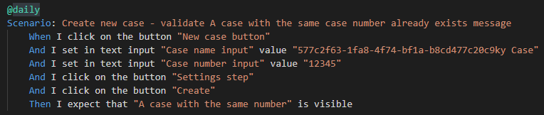
1. Cucumber & Gherkin - Features and Scenarios
Tests are written in Gherkin syntax that means that you write down what's supposed to happen in a real language using the Given, When, Then keywords
Given <Context or state>
When <action occurs>
Then <observable outcome>
All test files are located in ./src/features/* and have the file ending .feature
For example: we want to test when entering an already case number - the correct message appears

Slide 5
2. Step definition - using webdriver.io
Step definition maps the Test Case Steps in the feature files (introduced by Given/When/Then) to code. You define your snippet using regular expressions. This is pretty powerful as it allows you to create complex sentences with multiple options. Everything that's within "([^"]*)?" gets captured and appended to the callback. The last argument is always a callback function that you need to call when your step is done.
You can access the browser and your WebdriverIO instance with browser.
e.g.
browser.url ('http://google.com')
browser.pause (3000)
browser.closeWindow ()

Slide 6
2. Step definition - using webdriver.io - continued
Given step e.g.
I open the (url|site) "([^"]*)?"
Open a site in the current browser window/tab
When step e.g.
I (click|doubleclick) on the (link|button|element) "([^"]*)?"
(Double) click a link, button or element
Then step e.g.
I expect that the title is( not)* "([^"]*)?"
Check the title of the current browser window/tab

Slide 7
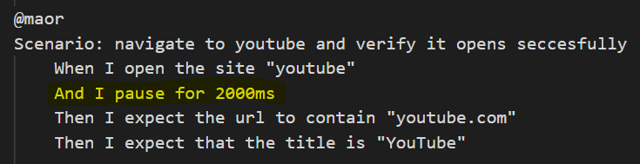
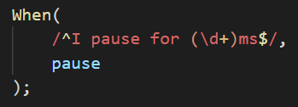
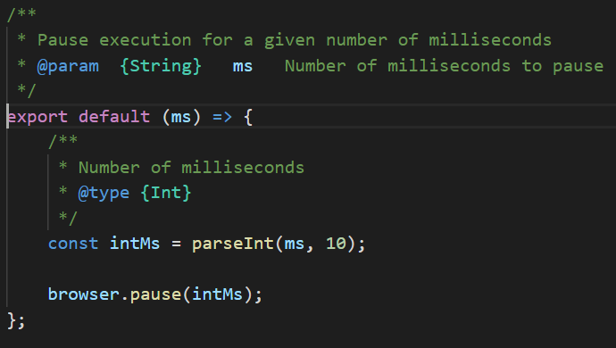
E.g. pause action
Gherkin
Step definition using regex and webdriver.io API

Slide 8
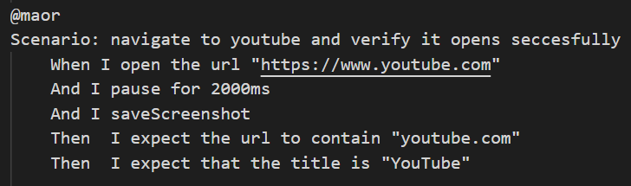
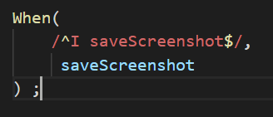
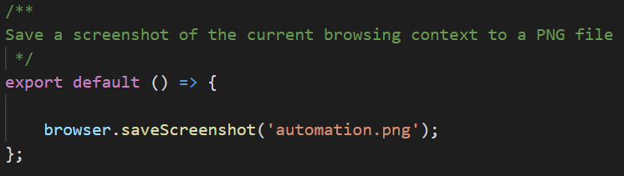
Adding new Gherkin step with it’s step definition e.g. I saveScreenshot
Reading the API -> https://webdriver.io/docs/api/browser/saveScreenshot.html

Slide 9
3. Chai Assertion Library
Chai used to verify, if we have reached the expected condition or not.
It use keywords: Should, Expect, Assert.
e.g.
parsedExpectedText.should.equal(text);
expect(hasFocus).to.equal(true, 'Expected element to be focused, but it is not');
assert (e, 'A prompt was not open when it should have been open');

Slide 10
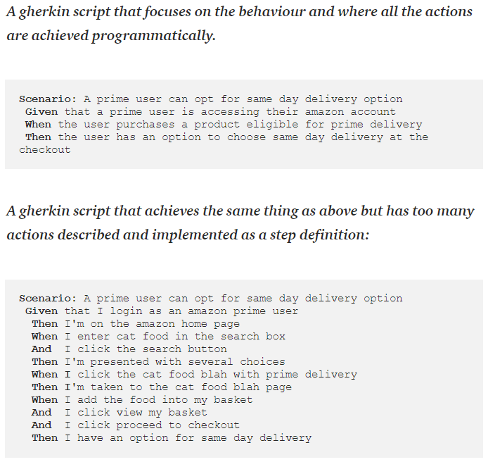
Best Practices to adding new tests - Gherkin
A Guide to Cucumber Best Practices
https://dzone.com/articles/a-guide-to-good-cucumber-practices
https://automationpanda.com/2017/01/30/bdd-101-writing-good-gherkin/
https://github.com/department-of-veterans-affairs/ascent-sample/wiki/QA-:-Gherkins-Standards-and-Best-Practices

Slide 11
Best Practices to adding new tests - Gherkin
1. Write declarative features
Scenarios should be written like a user would describe them.
2. Insert a narrative
Narratives describe in about one sentence what a feature does.(without
reading the scenarios.)
3. Avoid conjunctive steps
Sticking to one action per step makes your steps more modular and
increases reusability.
4. Reuse step definitions
You should try to reuse steps as often as possible. This will improve the
maintainability of your app:
5. Use backgrounds wisely
If you use the same steps at the beginning of all scenarios of a feature, put
them into the feature’s Background. Background steps are run before each
scenario.

Slide 12
Use backgrounds wisely – e.g. login
Background in Cucumber is used to define a step or series of steps which are common to all the tests in the feature file. It allows you to add some context to the scenarios for a feature where it is defined. A Background is much like a scenario containing a number of steps. But it runs before each and every scenario where for a feature in which it is defined.
Feature: When I click on the New case button from Cases, i'm able to create new case using the wizard steps
Background: Background name: login as admin
Given Admin "Blake" exists
Given I am logged in as admin user "Blake"
@daily
Scenario: Create new case - validate Properties step opens as expected
When I click on the button "New case button"
And "Case window title" is loaded successfully
Then "Properties step" is loaded successfully
Then "Help menu" is loaded successfully
@daily
Scenario: Create new case - validate help menu options available: User manual & WalkMe
When I click on the button "New case button"
And I click on the button "Help menu"
Then I expect that "User manual" is visible
Then I expect that "WalkMe menu" is visible
Then "Case path" is loaded successfully

Slide 13
Use Scenario outline wisely
The Scenario Outline keyword can be used to run the same Scenario multiple times,
with different combinations of values.
Feature: Calculator
As a user
I want to use a calculator to add numbers
So that I don't need to add myself
Scenario Outline: Add two numbers <num1> & <num2>
Given I have a calculator
When I add <num1> and <num2>
Then the result should be <total>
Examples:
| num1 | num2 | total |
| -2 | 3 | 1 |
| 10 | 15 | 25 |
| 99 | -99 | 0 |
| -1 | -10 | -11 |

Slide 14
Pushed tests to master - guidelines
Check your recently added tests for several days after pushed to master to make sure they are consistent and stable
Every new test that is pushed to master need to be re-tested on nightly (local host is not sufficient)
If settings are changed before a test, don’t forget to return to default settings so other tests will not be effected
If there is a change in a function that might effect other tests, need to run all possible effected tests – use npm run @api (uae-server) and npm run @daily (uae-client)

Slide 15

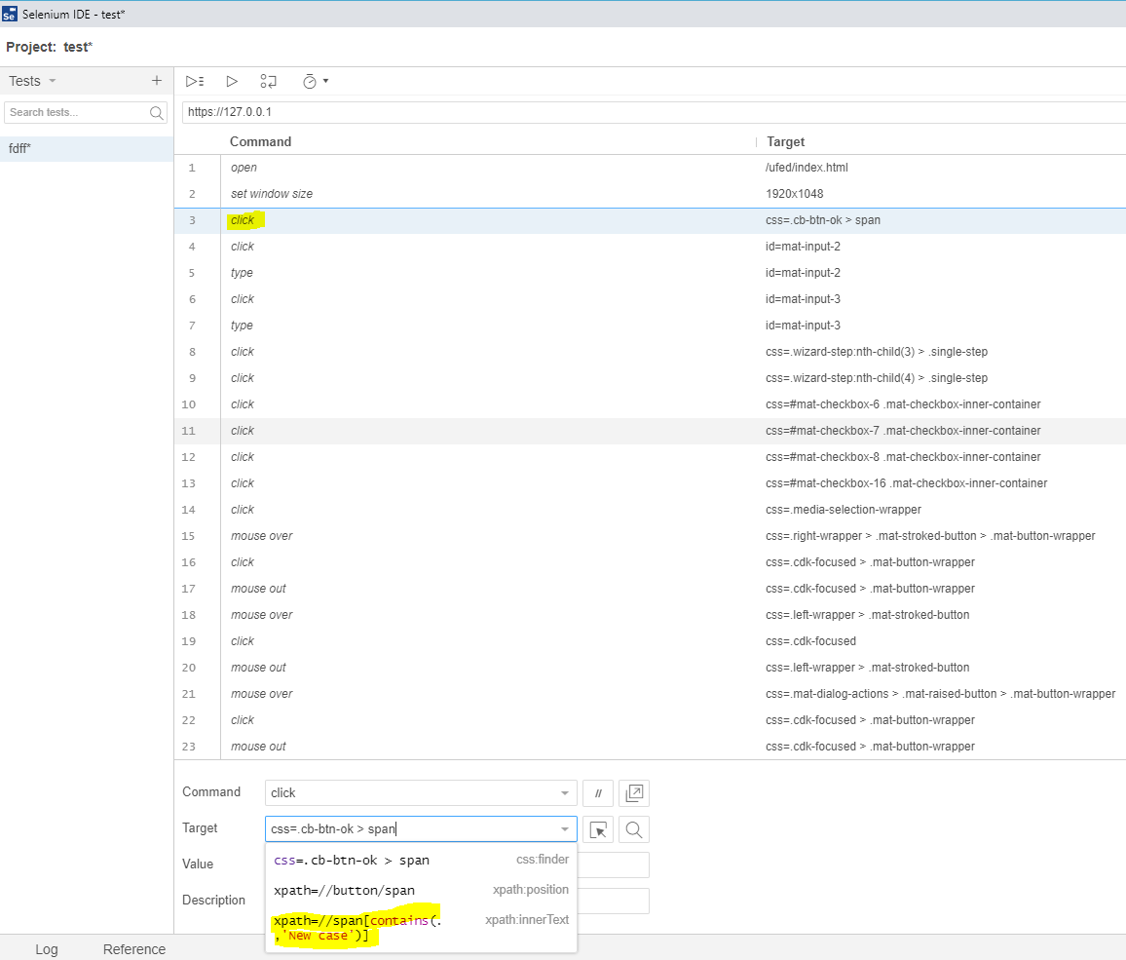
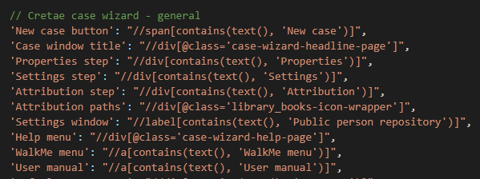
Finding XPATH Tips
1) Xpath cheatsheet
https://devhints.io/xpath
2) We use XPATH to locate and do actions on elements in our application.
You can use Selenium IDE chrome plugin to make your job easier for finding XPATH locators.

Slide 16
QA

